Slide 1
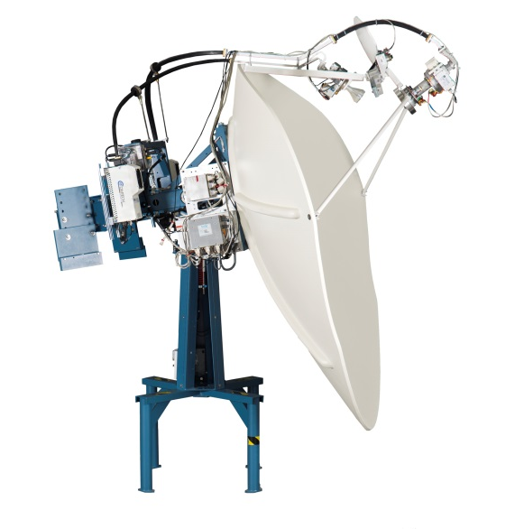
Satellite Antenna Overview
Karl Kapusta
CommSystems, LLC
12225 World Trade Dr. Ste.I
San Diego, CA. 92128
kkapusta@comm-systems.com
+1-858-824-0056

Slide 2
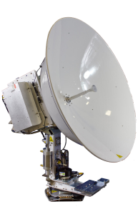
Seatel C/Ku-Band Series & Ku-Band Series Antennas
9711 IMA Dual Band Antenna
6012 IMA Ku-Band Antenna

Slide 3
9797B Antenna Systems
The 9797B is a 3-axis, (AZ, LV, CL), stabilized antenna system compatible with C-Band and Ku-Band satellites.
These antennas are based on the original design of the 9797 & 9797A systems.
The 9797B’s are fitted with the MK1 electronics which were also introduced on the original xx96 and xx06 Vsat range of products (4996, 4006, 6006 antennas).
The MK1 electronics include the following components:
Level Cage, with two gravity reference tilt sensors and three rate sensors.
Individual Servo Amplifiers, one for each motor subsystem (AZ, LV, CL)
Non Braked motors, one for each drive (AZ, LV, CL)
Separate AZ encoder and AZ motor
Matched pair of ADE and BDE FSK Multiplexors
The C-Band feed is Circular/Linear switchable
Ku-Band can be Co-pole and Cross-pol switchable
Switching between C-Band and Ku-Band is achieved by swapping out the feeds.
All systems are supplied with a DAC2202 antenna control unit.

Slide 4
9711 Antenna (2.4 meter antennas)
The 9711 is a 3-axis, (AZ, LV, CL), stabilized antenna system compatible with both C-Band and Ku-Band satellites.
These antennas are based on the older 9797B systems.
The 9711’s are fitted with the MK2 electronics which were also introduced on the xx09 Vsat range (4009, 6009 antennas).
With the MK2 electronics the following parts have been removed/ replaced.
Level Cage Sensors are now incorporated on a single Level Platform board in the PCU.
Servo AMPs were replaced with a single Motor Driver Board in the PCU.
Non Braked motors were replaced with Braked Motors.
The separate AZ Encoder & AZ Motor were replaced with a single AZ motor with a built in encoder.
The C-Band feed is Circular/Linear switchable
Ku-Band is Co-pole and Cross-pol switchable
Switching between C-Band and Ku-Band is achieved by swapping out the feeds.
All systems are supplied with a DAC-2202 antenna control unit.

Slide 5
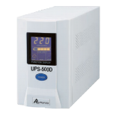
9797B & 9711 DAC Based Antenna Systems
DAC (Digital Antenna Controller) Systems Require:
External FSK Modems
Terminal Mounting Strip

Slide 6
9711IMA (Integrated Marine Antenna) Series Introduction
The 9711IMA is a 3-axis stabilized antenna system compatible with C-Band and Ku-Band satellites.
These antennas are based on the older 9711 systems.
The 9711IMA version is fitted with the IMA electronics, (MK3), which were also introduced on the xx12 series VSAT antennas (4012, 5012, 6012).
With the IMA electronics the following parts have been removed/ replaced.
The PCU was replaced with the ICU
The DAC was replaced with the MXP
Both C-Band and Ku-Band feeds are mounted on reflector feed assembly
The C-Band feed assembly is Circular/Linear switchable
Ku-Band feed assembly is Co-pol and Cross-pol switchable
Switching between C-Band and Ku-Band is controlled via the MXP and ICU.
All systems are supplied with a MXP.

Slide 7
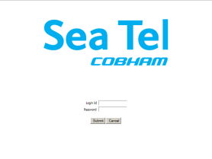
MXP – ICU Based Antenna Systems
MXP (Media Exchange Point) communicates with the ICU Antenna Controller
EOC (Ethernet- Over-Coax) communications between the ADE and BDE.
Ethernet or Serial Radio M&C communications available
No Terminal Mounting Strip, (TMS), required – all HDG, mode, and Operator interfaces are direct into the MXP

Slide 8
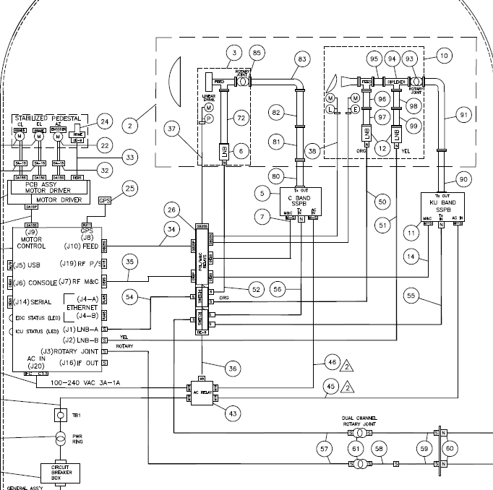
Dual Band Antenna Systems
Ku-band feed
Dual Band 9711IMA with
ICU and QOR switch
C-band feed
C-band BUC
QOR Switch Box
Ku-band BUC
ICU
RX coax
Polarization Harness
BUC coax

Slide 9
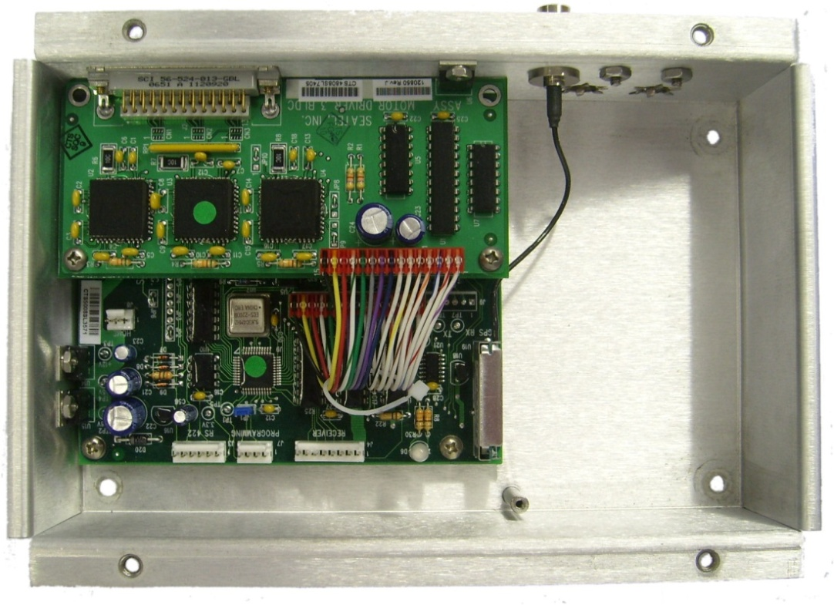
DAC 9797B & XX06 Antenna System PCU
The Level Cage is external to Central Processing Unit (PCU)
The Rx Receiver, (Tuner Card), is located in DAC
Motor Driver
PCU PCB

Slide 10
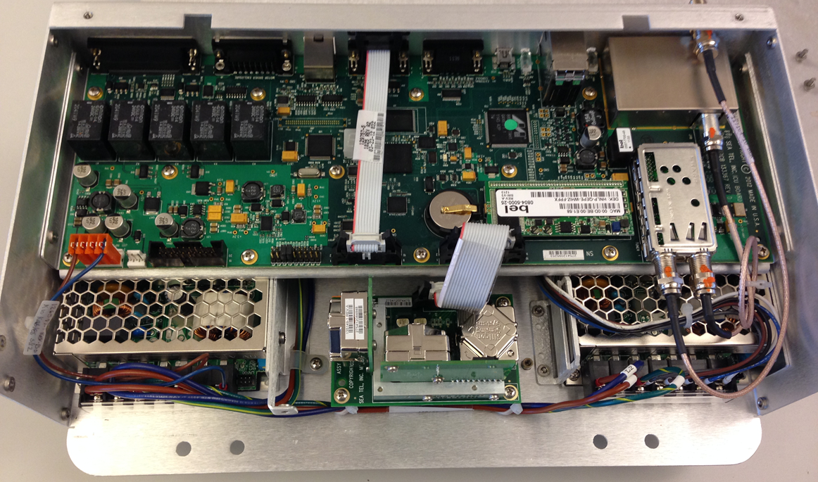
9711 IMA & XX12 Series IMA (Integrated Marine Antenna) ICU
On the IMA Series antennas, troubleshooting has been simplified by housing all the stabilization components inside the ICU
The ICU houses the Motherboard with tuner card, Level platform PCB and PSU’s.
Intelligent Level MEM sensors monitor the movement of the antenna throughout the elevation and cross level range providing live feedback to the ICU.
Originally, tracking was performed by the DAC. Currently, the ICU controls the tracking, and the tuner card is located within it.
ICU Mother PCB
Tuner card
BUC PSU
Level Platform
Antenna PSU

Slide 11
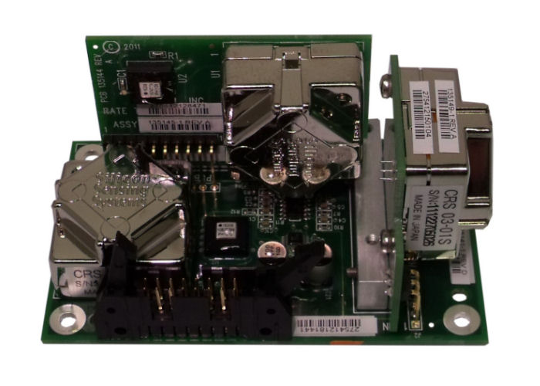
Gravity Reference and MEM Sensors
There are two sensors in the Level Cage and the Level Platform that provide CL and LV references for all the antenna’s movements.
In the stand alone Level Cage, they are called Gravity Reference (Tilt) Sensors. In the IMA Series antennas they are called MEM Sensors.
Each MEM Sensor is a Solid State Accelerometer, giving it’s feedback as a digital count, while the Tilt Sensors are analog, and require an Analog-to-Digital converter
MEM Sensors, (Micro Electro Mechanical sensors), are factory calibrated to provide an absolute reference to the Horizon
MEM sensors are less susceptible to G-forces & Vibration, making the IMA Series more stable
The LV MEM sensor calculates the antenna reflector’s Elevation position in relation to the Horizon. The CL MEM Sensor calculates the antenna reflector’s Cross Level position in relation to the Horizon
Both the Gravity Reference Sensors and MEM Sensors serve as the Antenna’s long term Stabilization references
LV MEM Sensor
CL MEM Sensor

Slide 12
Level Cage & Level Platform Rate Sensors
There are three rate sensors in both the stand alone Level Cage and on the Level Platform inside the ICU
These sensors detect movement and direction of the antenna mass, and provide this feedback to the DAC or ICU as fundamental data input that is required for the AZ, LV, and CL axis control loop calculations
Rate Sensor feedback is instant into the control loops, and can detect up to 90 degrees of motion per second
The Level Platform PCB holds 3 Rate Sensors, one for each Axis, but 2 of them are elevation dependent.
Z - PCU Mounting and Elevation dependent
X – PCU Mounting and Elevation dependent
Y – Elevation
Y (EL)
X or Z(CL or AZ)
Z or X(AZ or CL)

Slide 13
Control Loops
There are three Control Loops, one for each for the AZ, LV, & CL axis. Each Control Loop is the series of actions that constantly monitor the ship’s movements and causes motor drives in equal and opposite directions to the movements of the ship. This keeps the antenna pointed on the satellite.
Each Control Loop relies on the data input from the Reference and Rate Sensors to calculate the appropriate counter movement of the antenna.
Control Loops have a DC voltage range of 0.0 – 5.0 VDC. A Quiet Loop is when no motion is being detected, and in this situation, the Rate Sensors will be outputting a nominal 2.5VDC
When the vessel rolls 5 degrees, the voltage in the control loop will change off of the nominal 2.5 VDC, (either increase or decrease), and 5 degrees of drive in the opposite direction will be issued to the Cross Level axis. This returns the control loop to the nominal 2.5 VDC, and keeps the antenna level to the Horizon as per the antenna’s Horizon Reference
All motor drives are issued instantly as the vessel moves.
All motor drive is done in 1/12th of a degree.
Targeting the antenna introduces internal errors into all three Loops, (AZ, LV, CL). As each axis drives to the new target location, the errors will decrease & disappear when the antenna reaches its target position
When the Rate Sensor voltage increases the axis is moving clockwise
When the Rate Sensor voltage decreases the axis is moving counter-clockwise

Slide 14
Antenna Initialization Process
When the antenna is energized, (or commanded to re-initialize), the DAC or ICU runs the Initialization Process, which calibrates all 3 axes of the antenna. Initialization must be fully completed for the antenna to operate correctly
First, during initialization, the Elevation motor will provide drive to level the LV axis to the Horizon as per the MEM sensor output. Once the drive is complete, the antenna will be at 45 degrees elevation.
Next, the Cross Level motor will provide drive to level the CL axis to the Horizon as per the MEM sensor output. Once the drive is complete, the CL antenna angle to the Horizon will be zero.
Finally, the antenna will drive in Azimuth until the Home Flag Sensor is triggered via the metal tab just below the power ring. At this point, the antenna will be pointing in-line with the Bow of the ship, and the Relative count will be calibrated as 0 degrees (unless a HFO has been set by the AZ trim). The AZ Encoder will then count the Relative movement increments/decrements from this starting point.
The Relative position, (the reflector pointing direction relative to the bow of the ship), will be recalibrated on every full clockwise revolution (when the home flag is triggered)

Slide 15
Antenna Stabilization, Targeting, and Tracking
There are three basic processes the antenna system must perform successfully for the antenna to operate correctly and reliably. They are: Stabilization, Targeting, and Tracking.
Antenna Stabilization - The process of accurately maintaining the antenna at a specific angular position in 3-dimensional free space. This process is controlled by the Pedestal Controller, (either PCU or ICU), and requires input from the Level Cage or Level Platform Sensors, plus the ship’s Lat, Long, and HDG. It requires that the antenna is capable of moving freely in all three axes (Azimuth, Elevation, and Cross Level)
Satellite Targeting - The process of driving the antenna to the calculated Azimuth & Elevation angles of the desired satellite. The process is controlled by the Antenna Controller, (DAC or ICU). The Controller calculates the 3-dimensional location of the satellite based on the ship’s Lat, Long, HDG, & the Sat Longitude, and drives the antenna to point at that location.
Satellite Tracking – The process of the Antenna Controller, (DAC or ICU), actively optimizing the pointing of the reflector for maximum signal reception. This process, (DishScan), continuously makes small movements of the reflector while monitoring the AGC level of the received signal. The Controller evaluates this information and uses it to constantly make minor pointing corrections to keep the signal level “peaked” as part of normal

Slide 16
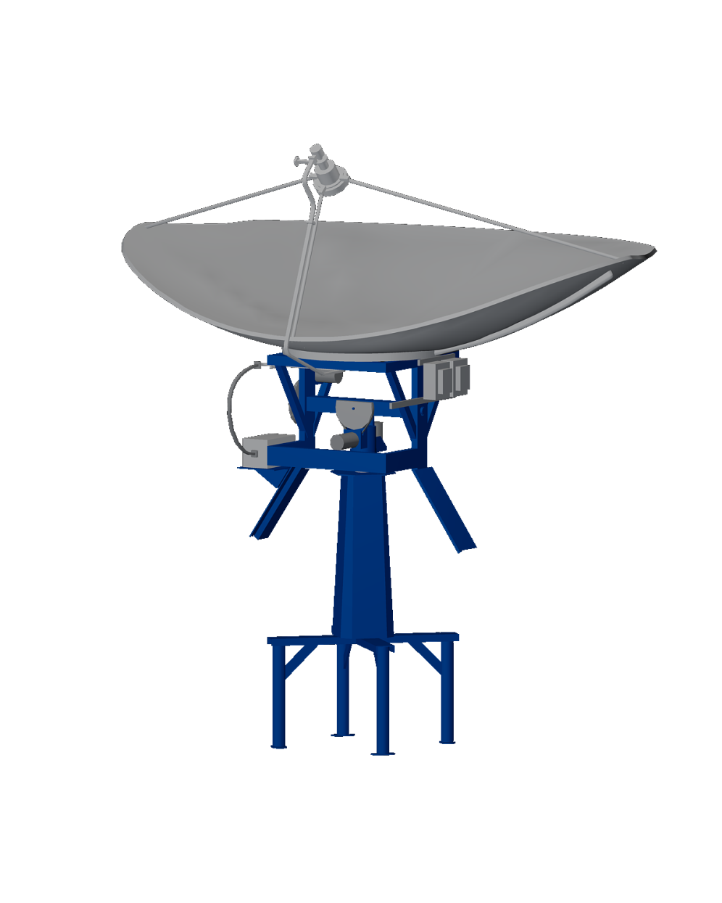
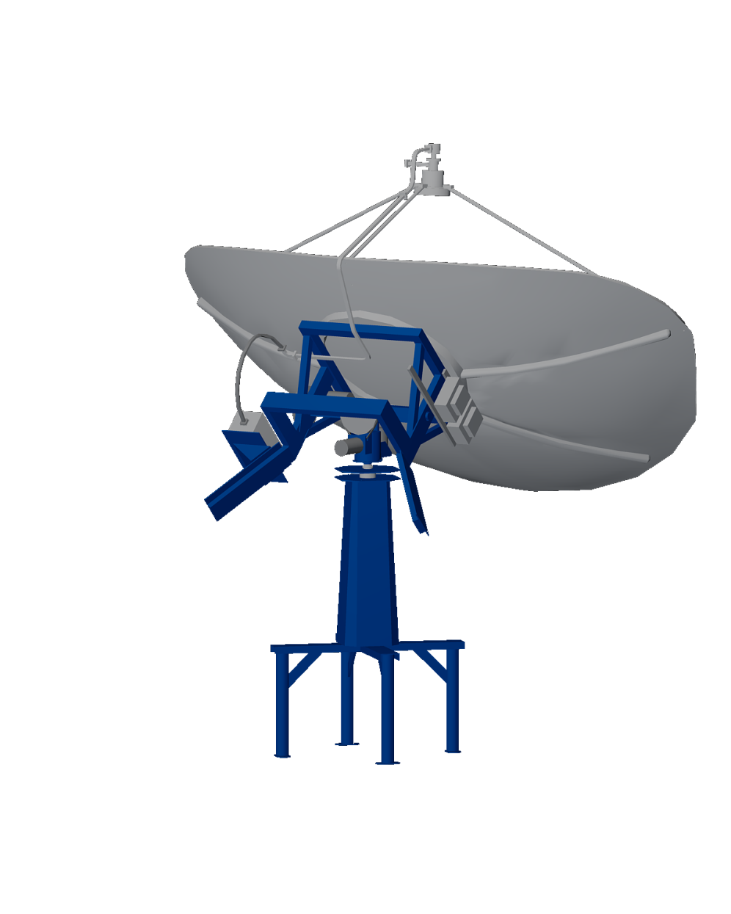
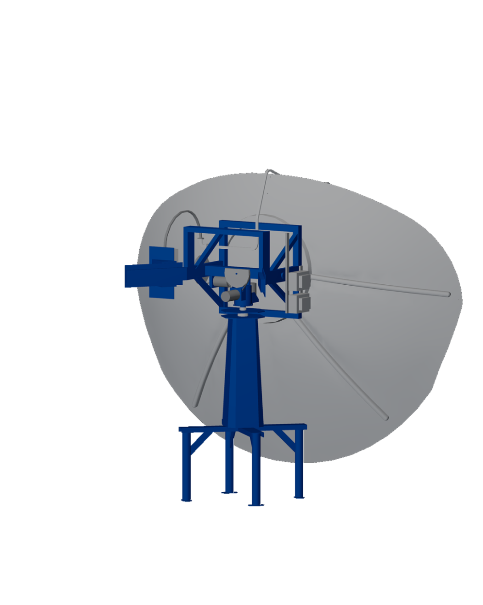
Antenna Balance
Antenna balance is critical, because the resultant inertia is responsible for the majority of the antenna’s stability.
All 3 axes of the antenna are balanced, as well as the feed assembly.
The Elevation & Cross Level axes are balanced throughout their ranges.
Changing components such as LNB’s or radio packages will require the antenna pedestal to be rebalanced.
Check at 80°
Check at 45°
Check at 10°

Slide 17
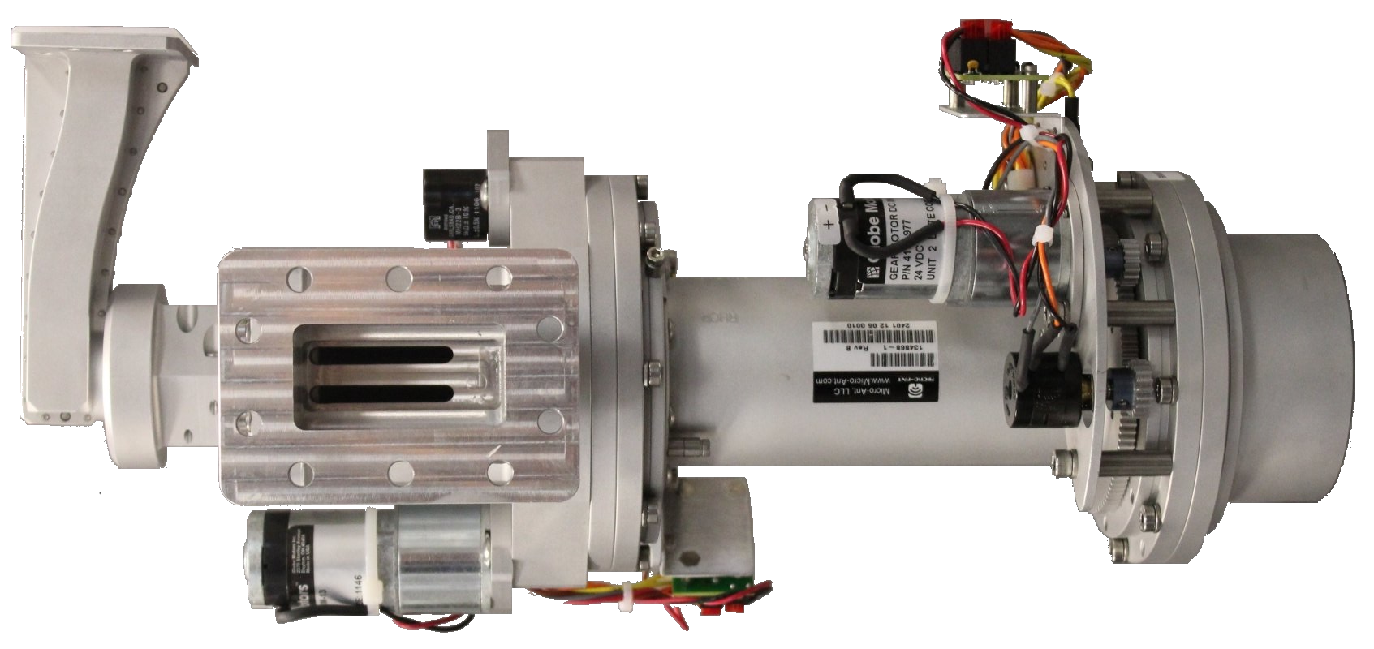
C band Circular and Linear Switchable P/N 134869-1
When the feed is driven for Linear polarization the Circular part lines up with the Linear mark then the complete feed is driven.
When the feed is driven for Circular LHCP, RHCP or for Linear mode this part of the feed is driven.
There may also be movement in this part of the feed for alignment when in Circular mode.
May 2014

Slide 18
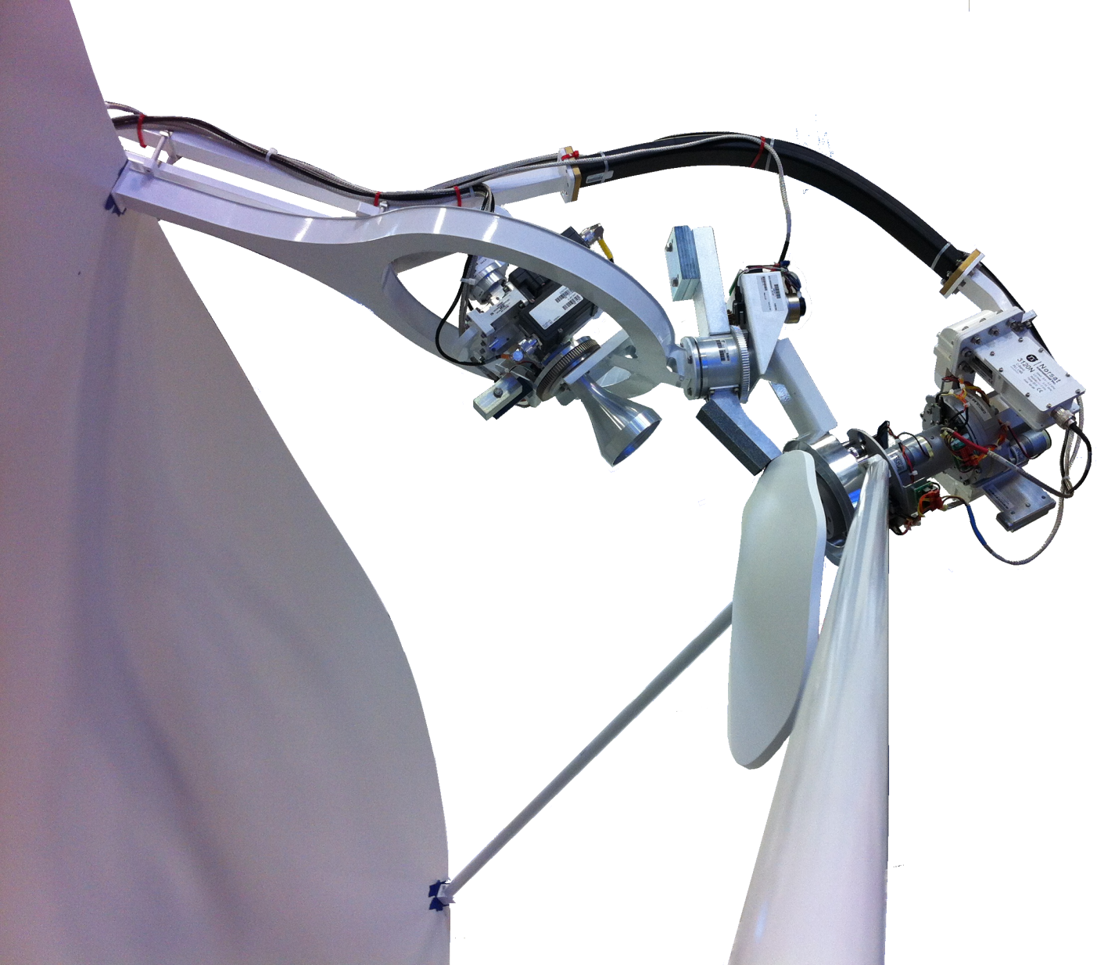
Ku-Band Feed - Dual band antenna
When the Ku-Band is selected the sub reflector is driven into place which blocks the C band feed.
May 2014

Slide 19
Questions?

